Slide 1
Graphics and sound

Slide 2
GUI
In computing a graphical user interface (GUI, sometimes pronounced gooey) is a type of user interface that allows users to interact with electronic devices with images rather than text commands. GUIs can be used in computers, hand-held devices such as MP3 players, portable media players or gaming devices, household appliances and office equipment . A GUI represents the information and actions available to a user through graphical icons and visual indicators such as secondary notation, as opposed to text-based interfaces, typed command labels or text navigation. The actions are usually performed through direct manipulation of the graphical elements.

Slide 3
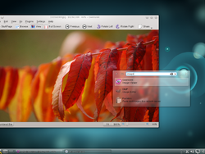
Screenshot of KDE Plasma Desktop GUI.

Slide 4
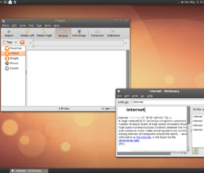
A screenshot of the GNOME GUI.

Slide 5
precursors
A precursor to GUIs was invented by researchers at the Stanford Research Institute, led by Douglas Engelbart. They developed the use of text-based hyperlinks manipulated with a mouse for theOn-Line System. The concept of hyperlinks was further refined and extended to graphics by researchers at Xerox PARC, who went beyond text-based hyperlinks and used a GUI as the primary interface for the Xerox Alto computer. Most modern general-purpose GUIs are derived from this system. As a result, some people call this class of interface a PARC User Interface (PUI) (note that PUI is also an acronym for perceptual user interface).
Ivan Sutherland developed a pointer-based system called the Sketchpad in 1963. It used a light-pen to guide the creation and manipulation of objects in engineering drawings.

Slide 6
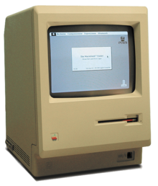
The Macintosh 128K was the first commercially successful personal computer to use a graphical user interface

Slide 7
PARC user interface
The PARC user interface consisted of graphical elements such as windows, menus, radio buttons, check boxes and icons. The PARC user interface employs a pointing device in addition to a keyboard. These aspects can be emphasized by using the alternative acronym WIMP, which stands for windows, icons, menus and pointing device.

Slide 8
Evolution
Following PARC the first GUI-centric computer operating model was the Xerox 8010 Star Information System in 1981, followed by the Apple Lisa (which presented the concept of menu bar as well as window controls) in 1983, the Apple Macintosh 128K in 1984, and the Atari ST and Commodore Amiga in 1985.
The GUIs familiar to most people today are Microsoft Windows, Mac OS X, and X Window System interfaces. Apple, IBM and Microsoft used many of Xerox's ideas to develop products, and IBM's Common User Access specifications formed the basis of the user interface found in Microsoft Windows, IBM OS/2 Presentation Manager, and the Unix Motif toolkit and window manager. These ideas evolved to create the interface found in current versions of Microsoft Windows, as well as in Mac OS X and various desktop environments for Unix-like operating systems, such asLinux. Thus most current GUIs have largely common idioms.

Slide 9
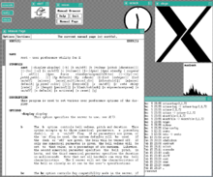
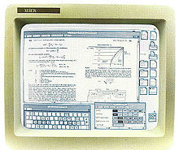
an early-1990s style Unix desktop running the X Window System graphical user interface in left and The Xerox Star Workstation introduced the first GUI operating systems as shown in right

Slide 10
WIMP
A series of elements conforming a visual language have evolved to represent information stored in computers. This makes it easier for people with few computer skills to work with and use computer software. The most common combination of such elements in GUIs is the WIMP ("window, icon, menu, pointing device") paradigm, especially in personal computers.
The WIMP style of interaction uses a physical input device to control the position of a cursor and presents information organized in windows and represented with icons. Available commands are compiled together in menus, and actions are performed making gestures with the pointing device. A window manager facilitates the interactions between windows, applications, and the windowing system. The windowing system handles hardware devices such as pointing devices and graphics hardware, as well as the positioning of the cursor.
In personal computers all these elements are modeled through a desktop metaphor, to produce a simulation called a desktop environment in which the display represents a desktop, upon which documents and folders of documents can be placed. Window managers and other software combine to simulate the desktop environment with varying degrees of realism.

Slide 11
Post-WIMP interfaces
Smaller mobile devices such as PDAs and smartphones typically use the WIMP elements with different unifying metaphors, due to constraints in space and available input devices. Applications for which WIMP is not well suited may use newer interaction techniques, collectively named as post-WIMP user interfaces.
Some touch-screen-based operating systems such as Apple's iOS and Android OS currently use post-WIMP styles of interaction. The iPhone's use of more than one finger in contact with the screen allows actions such as pinching and rotating, which are not supported by a single pointer and mouse.
A class of GUIs sometimes referred to as post-WIMP include 3D compositing window managers such as Compiz, Desktop Window Manager, and LG3D.^{[citation needed]} Some post-WIMP interfaces may be better suited for applications which model immersive 3D environments, such as Google Earth.

Slide 12
User interface and interaction design
Designing the visual composition and temporal behavior of GUI is an important part of software application programming. Its goal is to enhance the efficiency and ease of use for the underlying logical design of a stored program, a design discipline known as usability. Techniques of user-centered design are used to ensure that the visual language introduced in the design is well tailored to the tasks it must perform.
Typically, the user interacts with information by manipulating visual widgets that allow for interactions appropriate to the kind of data they hold. The widgets of a well-designed interface are selected to support the actions necessary to achieve the goals of the user. A Model-view-controller allows for a flexible structure in which the interface is independent from and indirectly linked to application functionality, so the GUI can be easily customized. This allows the user to select or design a different skin at will, and eases the designer's work to change the interface as the user needs evolve. Nevertheless, good user interface design relates to the user, not the system architecture.
The visible graphical interface features of an application are sometimes referred to as "chrome".Larger widgets, such as windows, usually provide a frame or container for the main presentation content such as a web page, email message or drawing. Smaller ones usually act as a user-input tool.

Slide 13
User interface and interaction design(CONTD)
A GUI may be designed for the rigorous requirements of a vertical market. This is known as an "application specific graphical user interface." Among early application specific GUIs was Gene Mosher's 1986 Point of Sale touchscreen GUI. Other examples of an application specific GUIs are:
Self-service checkouts used in a retail store
Automated teller machines (ATM)
Airline self-ticketing and check-in
Information kiosks in a public space, like a train station or a museum
Monitors or control screens in an embedded industrial application which employ a real time operating system (RTOS).
The latest cell phones and handheld game systems also employ application specific touchscreen GUIs. Newer automobiles use GUIs in their navigation systems and touch screen multimedia centers.

